Slide 1
Auto-Captioning Using Facial Expression and Background Objects
(Team No: D20 )
Team Members:
Usha Kamble 01fe18bcs242
Rohit Kulkarni 01fe18bcs177
Sumegh Madawale 01fe15bcs209
Sougat Paul 01fe17bcs208
Under the Guidance of:
MS. Preeti T
MR. Mallikarjun Akki
KLE Technological University, Hubli
School of Computer Science and Engineering
y
March, 11 / 22

Slide 2
Introduction
Machine learning is the part of artificial intelligence in which machines trains themselves by learning and improving without the help of human effort and new programming.
Artificial Intelligence is the process of imitating intelligent behaviour in machines. Various examples of these behaviours include visual comprehension, speech identification or tasks including decision making etc.
The ultimate goal of the AI technology is to allow the machine to catch the user’s intentions or emotions by itself. Understanding the feelings and the action of the human becomes important in various human-centric services. This technology based on the human face is called facial expression recognition (FER) technology.

Slide 3
Motivation
In web development, it’s good practice to provide a description for any image that appears on the page so that an image can be read or heard as opposed to just seen.
This makes web content accessible. Automatic Captioning can help, make Google Image Search as good as Google Search, as then every image could be first converted into a caption and then search can be performed based on the caption.
CCTV cameras (Closed-circuit television cameras) are everywhere today, but along with viewing the world, if we can also generate relevant captions, then we can raise alarms as soon as there is some malicious activity going on somewhere. This could probably help reduce some crime and/or accidents.

Slide 4
Literature Survey
S.NO | Author | Name Of the Paper | PROPOSED METHOD | RESULT
1. | Erik Hjelm, Boon Kee Low | Face Detection | Neural Networks, Statistical Approaches, Comparative Evaluation | 89.4% ->accuracy
2. | Zheng Lian, Ya Li,Jianhua Tao, Jian Huang, Mingyue Niu | Expression Analysis Based on Face Regions in the Wild | Visualization model, CAM technique, Face region extraction | 82.69%->accuracy

Slide 5
Literature Survey
S.NO | Author | Name Of The paper | PROPOSED METHOD | RESULT
3. | Mukkamala Rohith Sri Sai | Object detection and identification | ResNet, R-CNN, SDD, MANet, SqueezeNet, InceptionV3, DenseNet | 91.49% ->accuray
2. | Shaikh Arbaz, Shaikh Sohail, Shaikh Rehan, Mubashir Khan | Image Sorting Using Object Detection and Face Recognition | YOLO algorithm,CNN | 70% ->accuracy

Slide 6
Problem definition:
Real-time facial emotion identification, with background-dependent auto captioning of the expression, as well as object detection.
Objectives:
Multiple person Facial Emotion Detection in a single frame.
Along with Emotion of each Person auto captioning the present situation.
Object detection in the frame and auto captioning. Implementing the above steps in the Real Time with WEB based application and backend developed in ML Architecture and functioning.

Slide 7
Dataset Details
YOLOV3 – real time data set
Two types – tiny -- large
It has a CFG and a weights file which are internally connected to the main YOLOV3 file.
It helps in detecting things in the frame, i.e. it will detect object and it will consider the background as well. Its main job is to Distinguish the objects and backgrounds separately.
Once it has been trained with face of a person, it will evrytime catch and display details it knows about that person. Each person and its data is stored in separate folders and they are named differently.

Slide 8
Detail design/algorithm

Slide 9
High Level Design/Methodology

Slide 10
High Level Design/Methodology Cont..

Slide 11
Suitable data structures and programming paradigm
Machine Learning
Deep Learning
CNN(Convolutional Neural Network)
Deep learning techniques making use of Convolutional Neural Networks (CNN) for object detection as shown in figure, are used extensively nowadays. Neural networks consist of multi-layered architecture including an input layer, many hidden layers and an output layer.

Slide 12
Suitable data structures and programming paradigm
R-CNN
R-CNN (Region-Convolutional Neural Network) shown in figure , is a region based approach using CNNs. Ross Girshick, Jeff Donahue, Trevor Darrell and Jitendra Malik have achieved a mean average precision (mAP) of 53.7% with more than 30% improvement .

Slide 13
Modern tools & techniques used
1) Anaconda framework ( Backend or advanced ML codes )
2) Atom ( frontend and web app development )
In anaconda we are mainly using Jupiter Notebook and Spyder
And techniques or models such as TensorFlow, Keras and Scipy.
In Atom we will build the front end with functionalities like uploading image or real time capture using front camera of the laptop or mobile.
We will be mainly using HTML, CSS & Bootstrap

Slide 14
Module implementation & integration
Capturing Realtime video and compare the images captured with previous data present with respect to weights and CFG files of YOLOV3 data set which we are using in our model building, training and testing.
Detection of face and object boundaries and it even shows how much percentage it matches with the data it already has and it has been trained for.

Slide 15
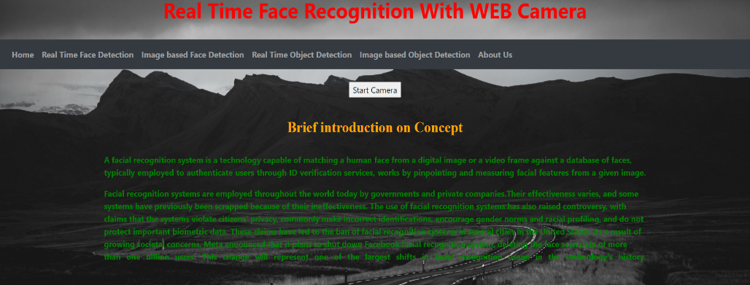
Results
Four categories
Real time face detection
Image based face detection
Real time object detection
Image based object detection

Slide 16
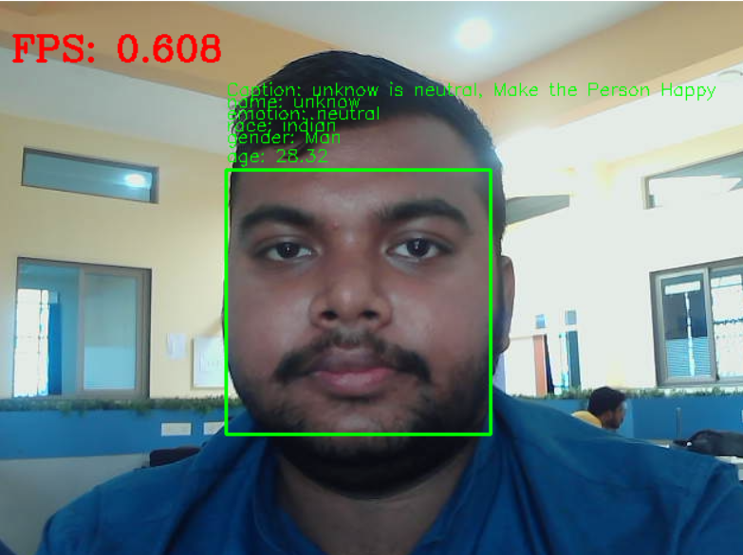
Results
Real time face detection

Slide 17
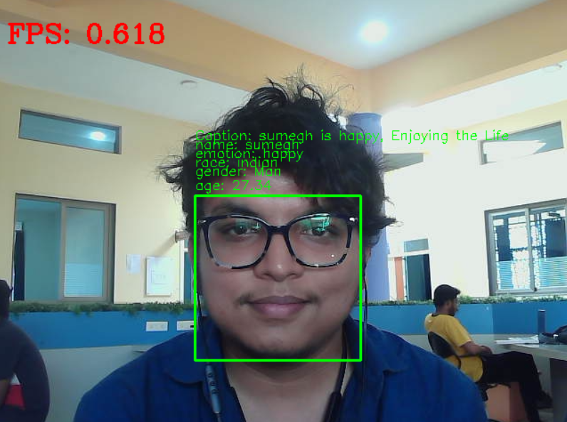
Results
Real time face detection

Slide 18
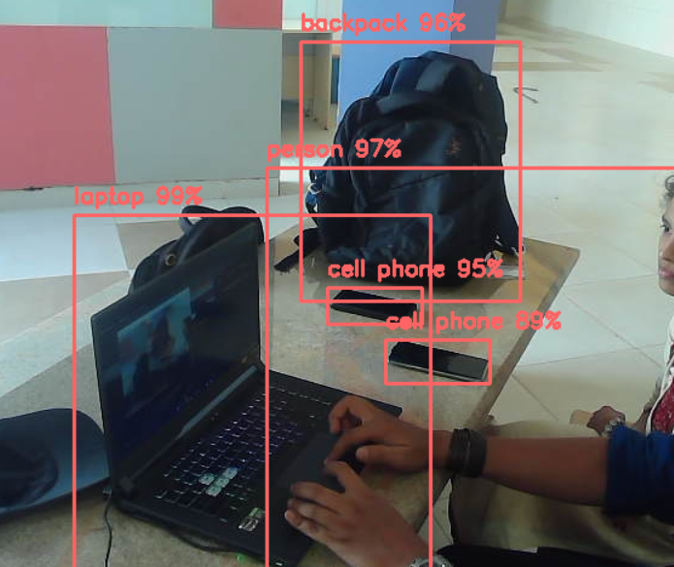
Results
Real time object detection

Slide 19
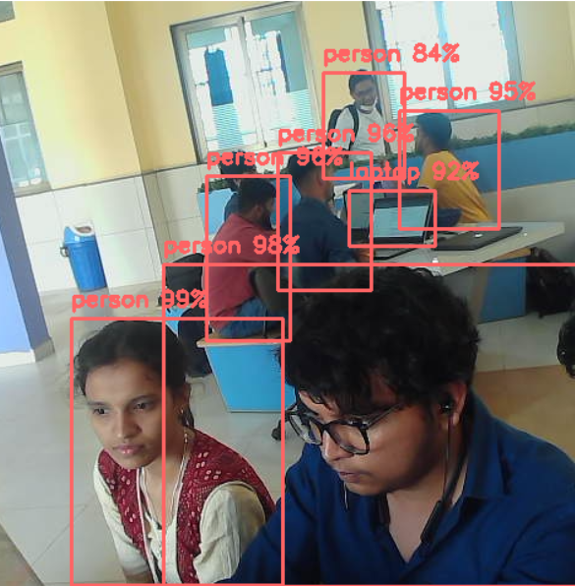
Results
Real time object detection

Slide 20
References
Zhao Z, Zheng P, Xu S and Wu X Object Detection with Deep Learning: A Review2019IEEE Transactions on Neural Networks and Learning Systems 30 3212.
Girshick R, Donahue J, Darrell T and Malik J Rich feature hierarchies for accurate object detection and semantic segmentation 2014 IEEE Conference on Computer Vision and Pattern Recognition(Columbus, OH)pp 580-587
Girshik R Fast R-CNN 2015IEEE International Conference on Computer Vision(Santiago) pp 1440-1448
Zhong-Qiu Zhao, Member, IEEE, Peng Zheng, Shou-tao Xu, and Xindong Wu, Fellow, IEEE 2019.
Byoung Chul Ko Department of Computer Engineering, Keimyung University, Daegu 42601 6 December 2017; Accepted: 25 January 2018; Published: 30 January 2018
Network security

Slide 21
Thank You

